Slide 1
Projective 2D & 3D geometry course 2

Slide 2
The projective plane
Why do we need homogeneous coordinates?
represent points at infinity, homographies, perspective projection, multi-view relationships
What is the geometric intuition?
a point in the image is a ray in projective space
-y
(sx,sy,s)
(x,y,1)
(0,0,0)
-z
x
image plane
Each point (x,y) on the plane is represented by a ray (sx,sy,s)
all points on the ray are equivalent: (x, y, 1) ≅ (sx, sy, s)

Slide 3
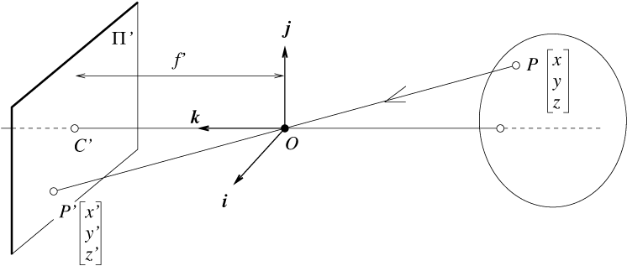
Perspective projection
camera
world
f
y
z
y’
Cartesian coordinates:
We have, by similar triangles, that (x, y, z) -> (f x/z, f y/z, -f)
Ignore the third coordinate, and get

Slide 4
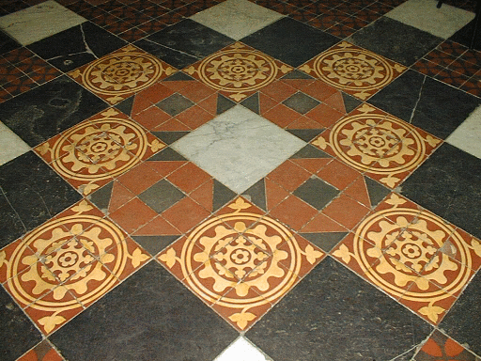
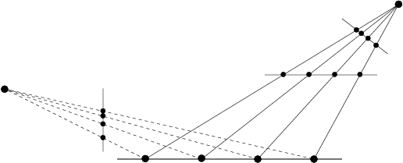
Projective 2D Geometry
Points, lines & conics
Transformations & invariants
1D projective geometry and
the Cross-ratio

Slide 5
Homogeneous coordinates
Homogeneous representation of lines
equivalence class of vectors, any vector is representative
Set of all equivalence classes in R³−(0,0,0)^{T} forms P²
Homogeneous representation of points
on
if and only if
The point x lies on the line l if and only if x^{T}l=l^{T}x=0
Homogeneous coordinates
but only 2DOF
Inhomogeneous coordinates

Slide 6
Points from lines and vice-versa
Intersections of lines
The intersection of two lines and is
Line joining two points
The line through two points and is
Example

Slide 7
Ideal points and the line at infinity
Intersections of parallel lines
Example
tangent vector
normal direction
Ideal points
Their inner product is zero
Line at infinity
Note that in P² there is no distinction
between ideal points and others
In projective plane, two distinct lines meet in a single point and
Two distinct points lie on a single line ➔ not true in R^2

Slide 8
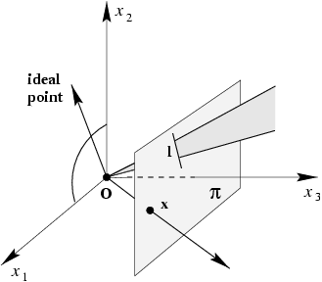
A model for the projective plane
Points in P^2 are represented by rays passing through origin in R^3.
Lines in P^2 are represented by planes passing through origin
Points and lines obtained by intersecting rays and planes by plane x3 = 1
Lines lying in the x1 – x2 plane are ideal points; x1-x2 plane is l_{infinity}

Slide 9
Duality
Roles of points and lines can be interchanged
Duality principle:
To any theorem of 2-dimensional projective geometry there corresponds a dual theorem, which may be derived by interchanging the role of points and lines in the original theorem

Slide 10
Conics
Curve described by 2nd-degree equation in the plane
or homogenized
or in matrix form
with
5DOF:

Slide 11
Five points define a conic
For each point the conic passes through
or
stacking constraints yields

Slide 12
Tangent lines to conics
The line l tangent to C at point x on C is given by l=Cx
l
x
C

Slide 13
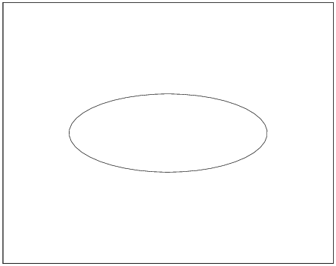
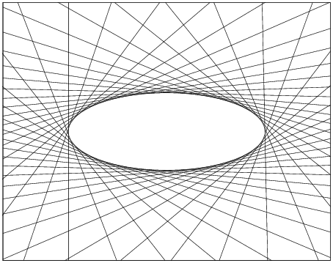
Dual conics
Conic C, also called, “point conic” defines an equation on points
Apply duality: dual conic or line conic defines an equation on lines
A line tangent to the conic C satisfies
C* is the adjoint of Matrix C; defined in Appendix 4 of H&Z
For nonsingular symmetric matrix, :
Dual conics = line conics = conic envelopes
Points lie on a point lines are tangent
conic to the point conic C; conic
C is the envelope of lines
l

Slide 14
Degenerate conics
A conic is degenerate if matrix C is not of full rank
e.g. two lines (rank 2)
e.g. repeated line (rank 1)
Degenerate line conics: 2 points (rank 2), double point (rank1)
Note that for degenerate conics

Slide 15
Projective transformations
Definition:
A projectivity is an invertible mapping h from P² to itself such that three points x₁,x₂,x₃ lie on the same line if and only if h(x₁),h(x₂),h(x₃) do. ( i.e. maps lines to lines in P²⁾
Theorem:
A mapping h:P²→P² is a projectivity if and only if there exist a non-singular 3x3 matrix H such that for any point in P² reprented by a vector x it is true that h(x)=Hx
Definition: Projective transformation: linear transformation on homogeneous 3 vectors represented by a non singular matrix H
or
8DOF
projectivity=collineation=projective transformation=homography
Projectivity form a group: inverse of projectivity is also a projectivity; so is a composition of two projectivities.

Slide 16
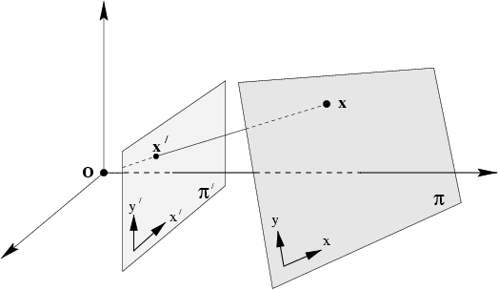
Projection along rays through a common point, (center of projection) defines a mapping from one plane to another
Central projection maps points on one plane to points on another plane
Projection also maps lines to lines : consider a plane through projection
center that intersects the two planes ➔ lines mapped onto lines ➔
Central projection is a projectivity ➔
central projection may be expressed by x’=Hx
(application of theorem)

Slide 17
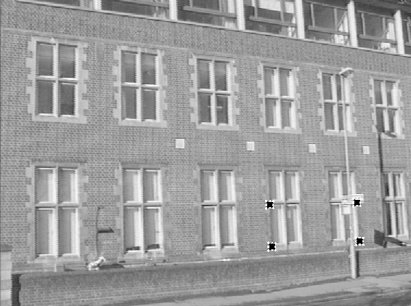
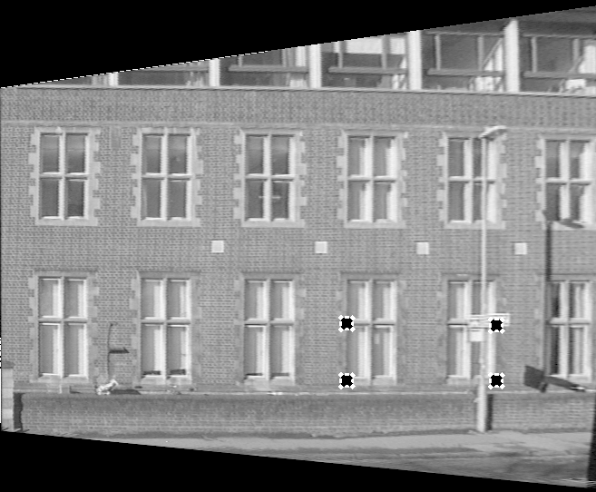
Removing projective distortion
Central projection image of a plane is related to the originial plane
via a projective transformation ➔ undo it by applying the inverse transformation
Let (x,y) and (x’,y’) be
inhomogeneous
Coordinates of a pair
of matching points
x and x’ in world and
image plane
select four points in a plane with known coordinates
(linear in h_{ij})
(2 constraints/point, 8DOF ⇒ 4 points needed)
Remark: no calibration at all necessary, better ways to compute (see later)
Sections of the image of the ground are subject to another projective distortion ➔
need another projective transformation to correct that.

Slide 18
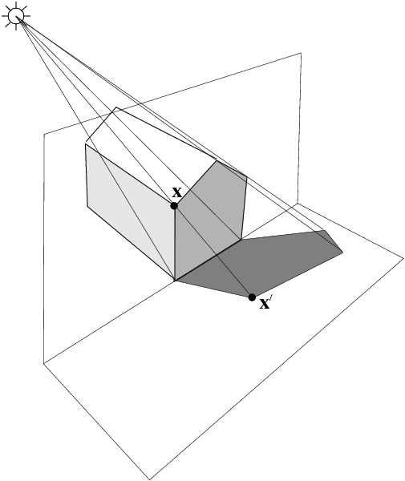
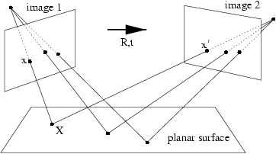
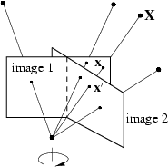
More examples
Projective transformation between two images
Induced by a world plane ➔ concatenation of two
Pojective transformations is also a proj. trans.
Proj. trans. Between the image of a plane
(end of the building) and the image of its
Shadow onto another plane (ground plane)
Proj. trans. Between two images with the same camera center
e.g. a camera rotating about its center

Slide 19
Transformation of lines and conics
For points on a line l, the transformed points under proj. trans.
also lie on a line; if point x is on line l, then transforming x, transforms l
For a point transformation
Transformation for lines
Transformation for conics
Transformation for dual conics

Slide 20
A hierarchy of transformations
Group of invertible nxn matrices with real elements ➔ general linear group on n dimensions GL(n);
Projective linear group: matrices related by a scalar multiplier PL(n); three subgroups:
Affine group (last row (0,0,1))
Euclidean group (upper left 2x2 orthogonal)
Oriented Euclidean group (upper left 2x2 det 1)
Alternative, characterize transformation in terms of elements or quantities that are preserved or invariant
e.g. Euclidean transformations (rotation and translation) leave distances unchanged
Similarity Affine projective
Similarity: circle imaged as circle; square as square; parallel or perpendicular lines have same relative orientation
Affine: circle becomes ellipse; orthogonal world lines not imaged as orthogonoal; But, parallel lines in the square remain parallel
Projective: parallel world lines imaged as converging lines; tiles closer to camera larger image than those further away.

Slide 21
Class I: Isometries: preserve Euclidean distance
(iso=same, metric=measure)
orientation preserving: ➔ Euclidean transf. i.e. composition of translation and rotation ➔ forms a group
orientation reversing: ➔ reflection ➔ does not form a group
R is 2x2 rotation matrix; (orthogonal, t is translation 2-vector, 0 is a null 2-vector
3DOF (1 rotation, 2 translation) ➔ trans. Computed from two point correspondences
special cases: pure rotation, pure translation
Invariants: length (distance between 2 pts) , angle between 2 lines, area

Slide 22
Class II: Similarities: isometry composed with an isotropic scaling
(isometry + scale)
4DOF (1 scale, 1 rotation, 2 translation) ➔ 2 point correspondences
Scalar s: isotropic scaling
also known as equi-form (shape preserving)
metric structure = structure up to similarity (in literature)
Invariants: ratios of length, angle, ratios of areas, parallel lines
Metric Structure means structure is defined up to a similarity

Slide 23
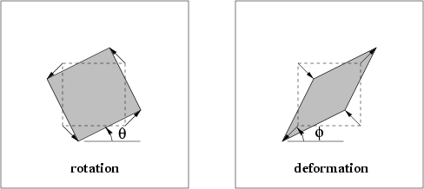
Class III: Affine transformations: non singular linear transformation followed by a translation
Rotation by theta R(-phi) D R(phi)
scaling directions
in the deformation
are orthogonal
Can show:
Rotation by phi, scale by D, rotation by – phi, rotation by theta
6DOF (2 scale, 2 rotation, 2 translation)➔ 3 point correspondences
non-isotropic scaling!
Invariants: parallel lines, ratios of parallel lengths,
ratios of areas
Affinity is orientation preserving if det (A) is positive ➔ depends on the sign of the scaling

Slide 24
Class IV: Projective transformations: general non singular linear transformation of homogenous coordinates
Hp has nine elements; only their ratio significant ➔ 8 Dof ➔ 4 correspondences
Not always possible to scale the matrix to make v unity: might be zero
Action non-homogeneous over the plane
Invariants: cross-ratio of four points on a line
(ratio of ratio of length)

Slide 25
Action of affinities and projectivities on line at infinity
Affine
Line at infinity stays at infinity,
but points move along line
Proj. trans.
Line at infinity becomes finite,
allows to observe/model vanishing points, horizon,

Slide 26
Decomposition of projective transformations
Decomposition valid if v not zero, and unique (if chosen s>0)
Useful for partial recovery of a transformation
upper-triangular,
Example:

Slide 27
Number of invariants?
The number of functional invariants is equal to, or greater than, the number of degrees of freedom of the configuration less the number of degrees of freedom of the transformation
e.g. configuration of 4 points in general position has 8 dof (2/pt)
and so 4 similarity, 2 affinity and zero projective invariants

Slide 28
Overview transformations
Concurrency, collinearity, order of contact (intersection, tangency, inflection, etc.), cross ratio
Projective
8dof
Parallellism, ratio of areas, ratio of lengths on parallel lines (e.g midpoints), linear combinations of vectors (centroids).
The line at infinity l∞
Affine
6dof
Similarity
4dof
Ratios of lengths, angles.
The circular points I,J
Euclidean
3dof
lengths, areas.

Slide 29
Projective geometry of 1D: P¹
Homogeneous coordinates of point x on line
Ideal point of a line
Projective transformation of a line:
3DOF (2x2-1) ➔ three corresponding points
The cross ratio
Is invariant under projective transformations in P^1.
Four sets of four collinear points; each set is related to the others by a line projectivity
Since cross ratio is an invariant under projectivity, the cross ratio has the same value for all the sets shown

Slide 30
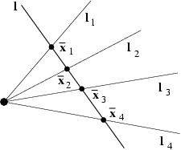
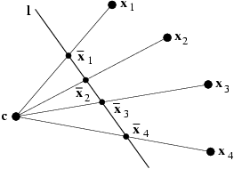
Concurrent Lines
Four concurrent lines l_i intersect the line l in the
four points x_i; The cross ratio of these points is
an invariant to the projective transformation of the plane
Coplanar points x_i are imaged onto a line by
a projection with center C. The cross ratio
of the image points x_i is invariant to the position of
the image line l

